Slide 1
Local Treatment of Rectal Cancer
Donald Weaver MD
Penberthy Professor and Chairman
Wayne State University School of Medicine
Department of Surgery
Detroit, Michigan

Slide 2
Everyone values their Rectum !
What is the crowning achievement of evolutionary man?
Hands
Rectum/Anus

Slide 3
Abdominal-perineal Resection
Most common operation done for rectal cancer before 1980’s
resulted in permanent colostomy
now we are in an era of organ preservation
many other options available

Slide 4
Lesions 5 -6 cm and below
Anterior resection for higher lesions
Lesions that formerly would have required AP resection

Slide 5
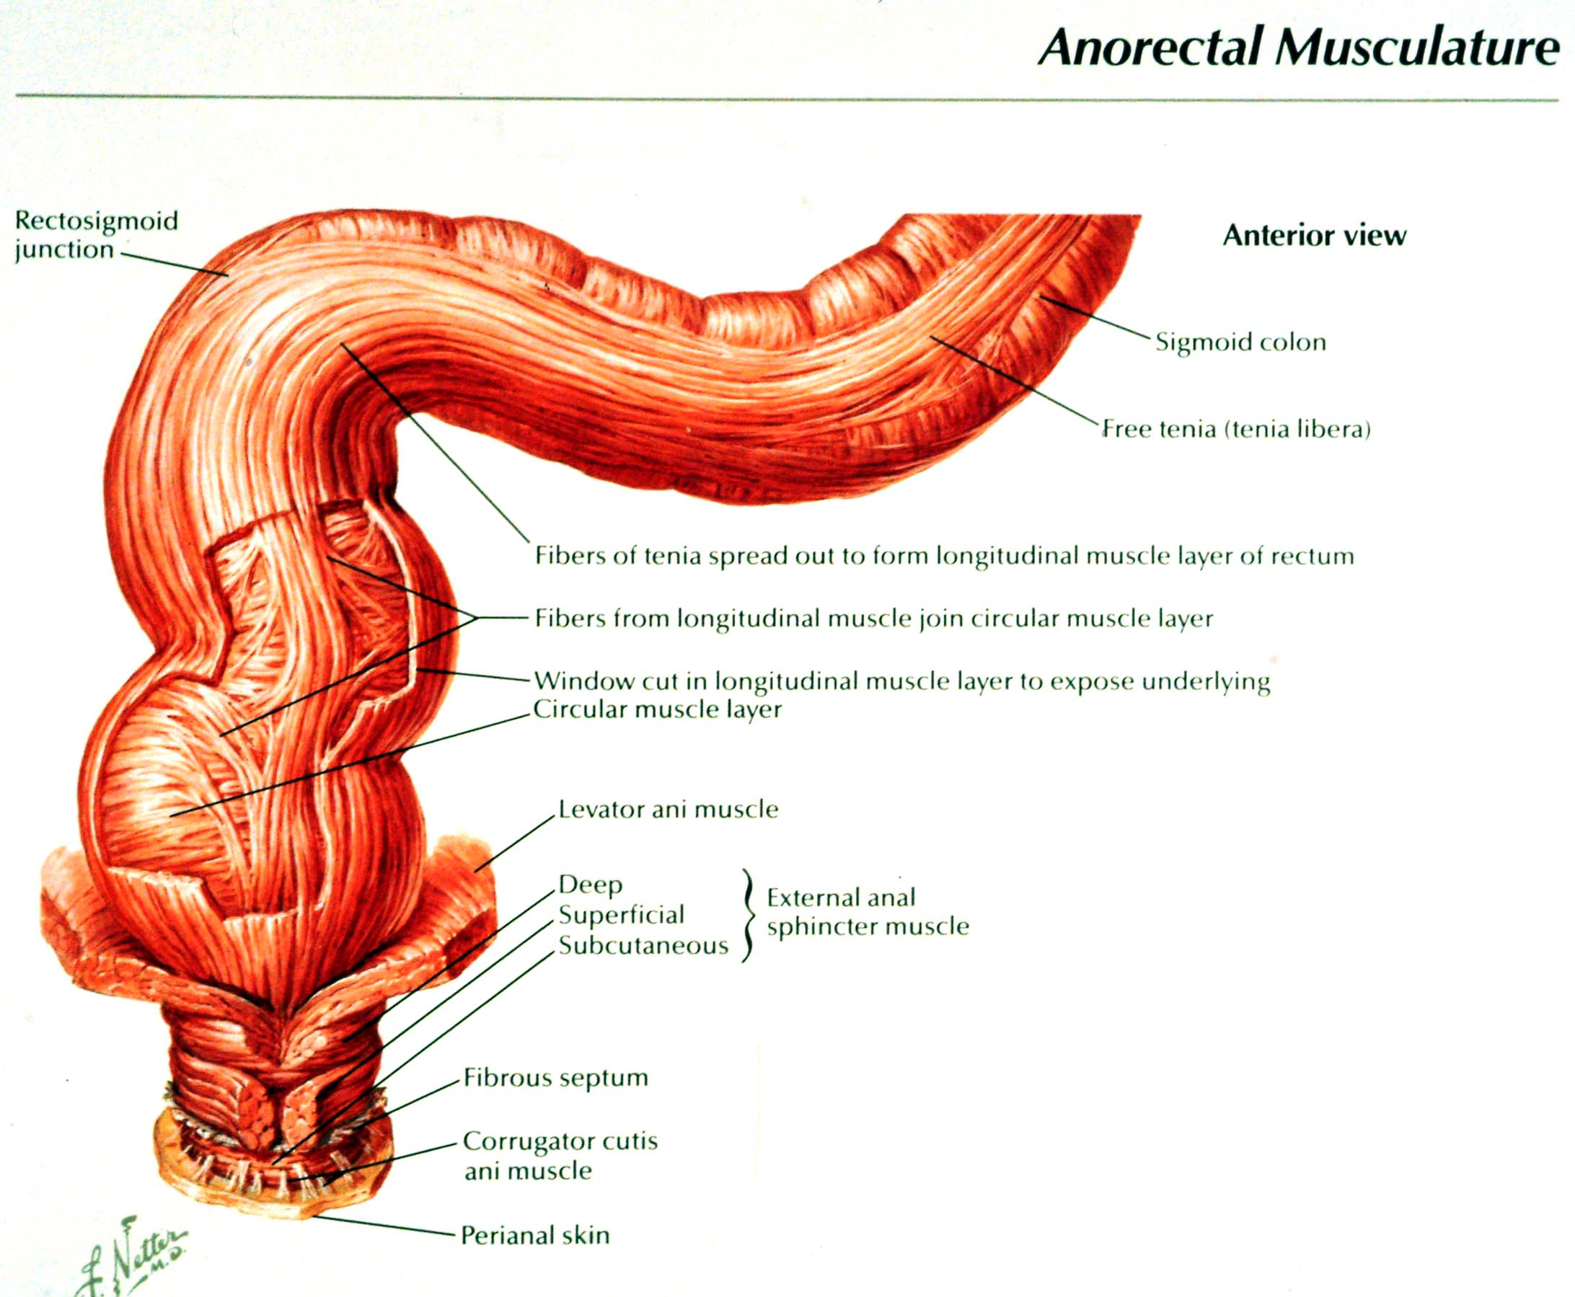

Slide 6
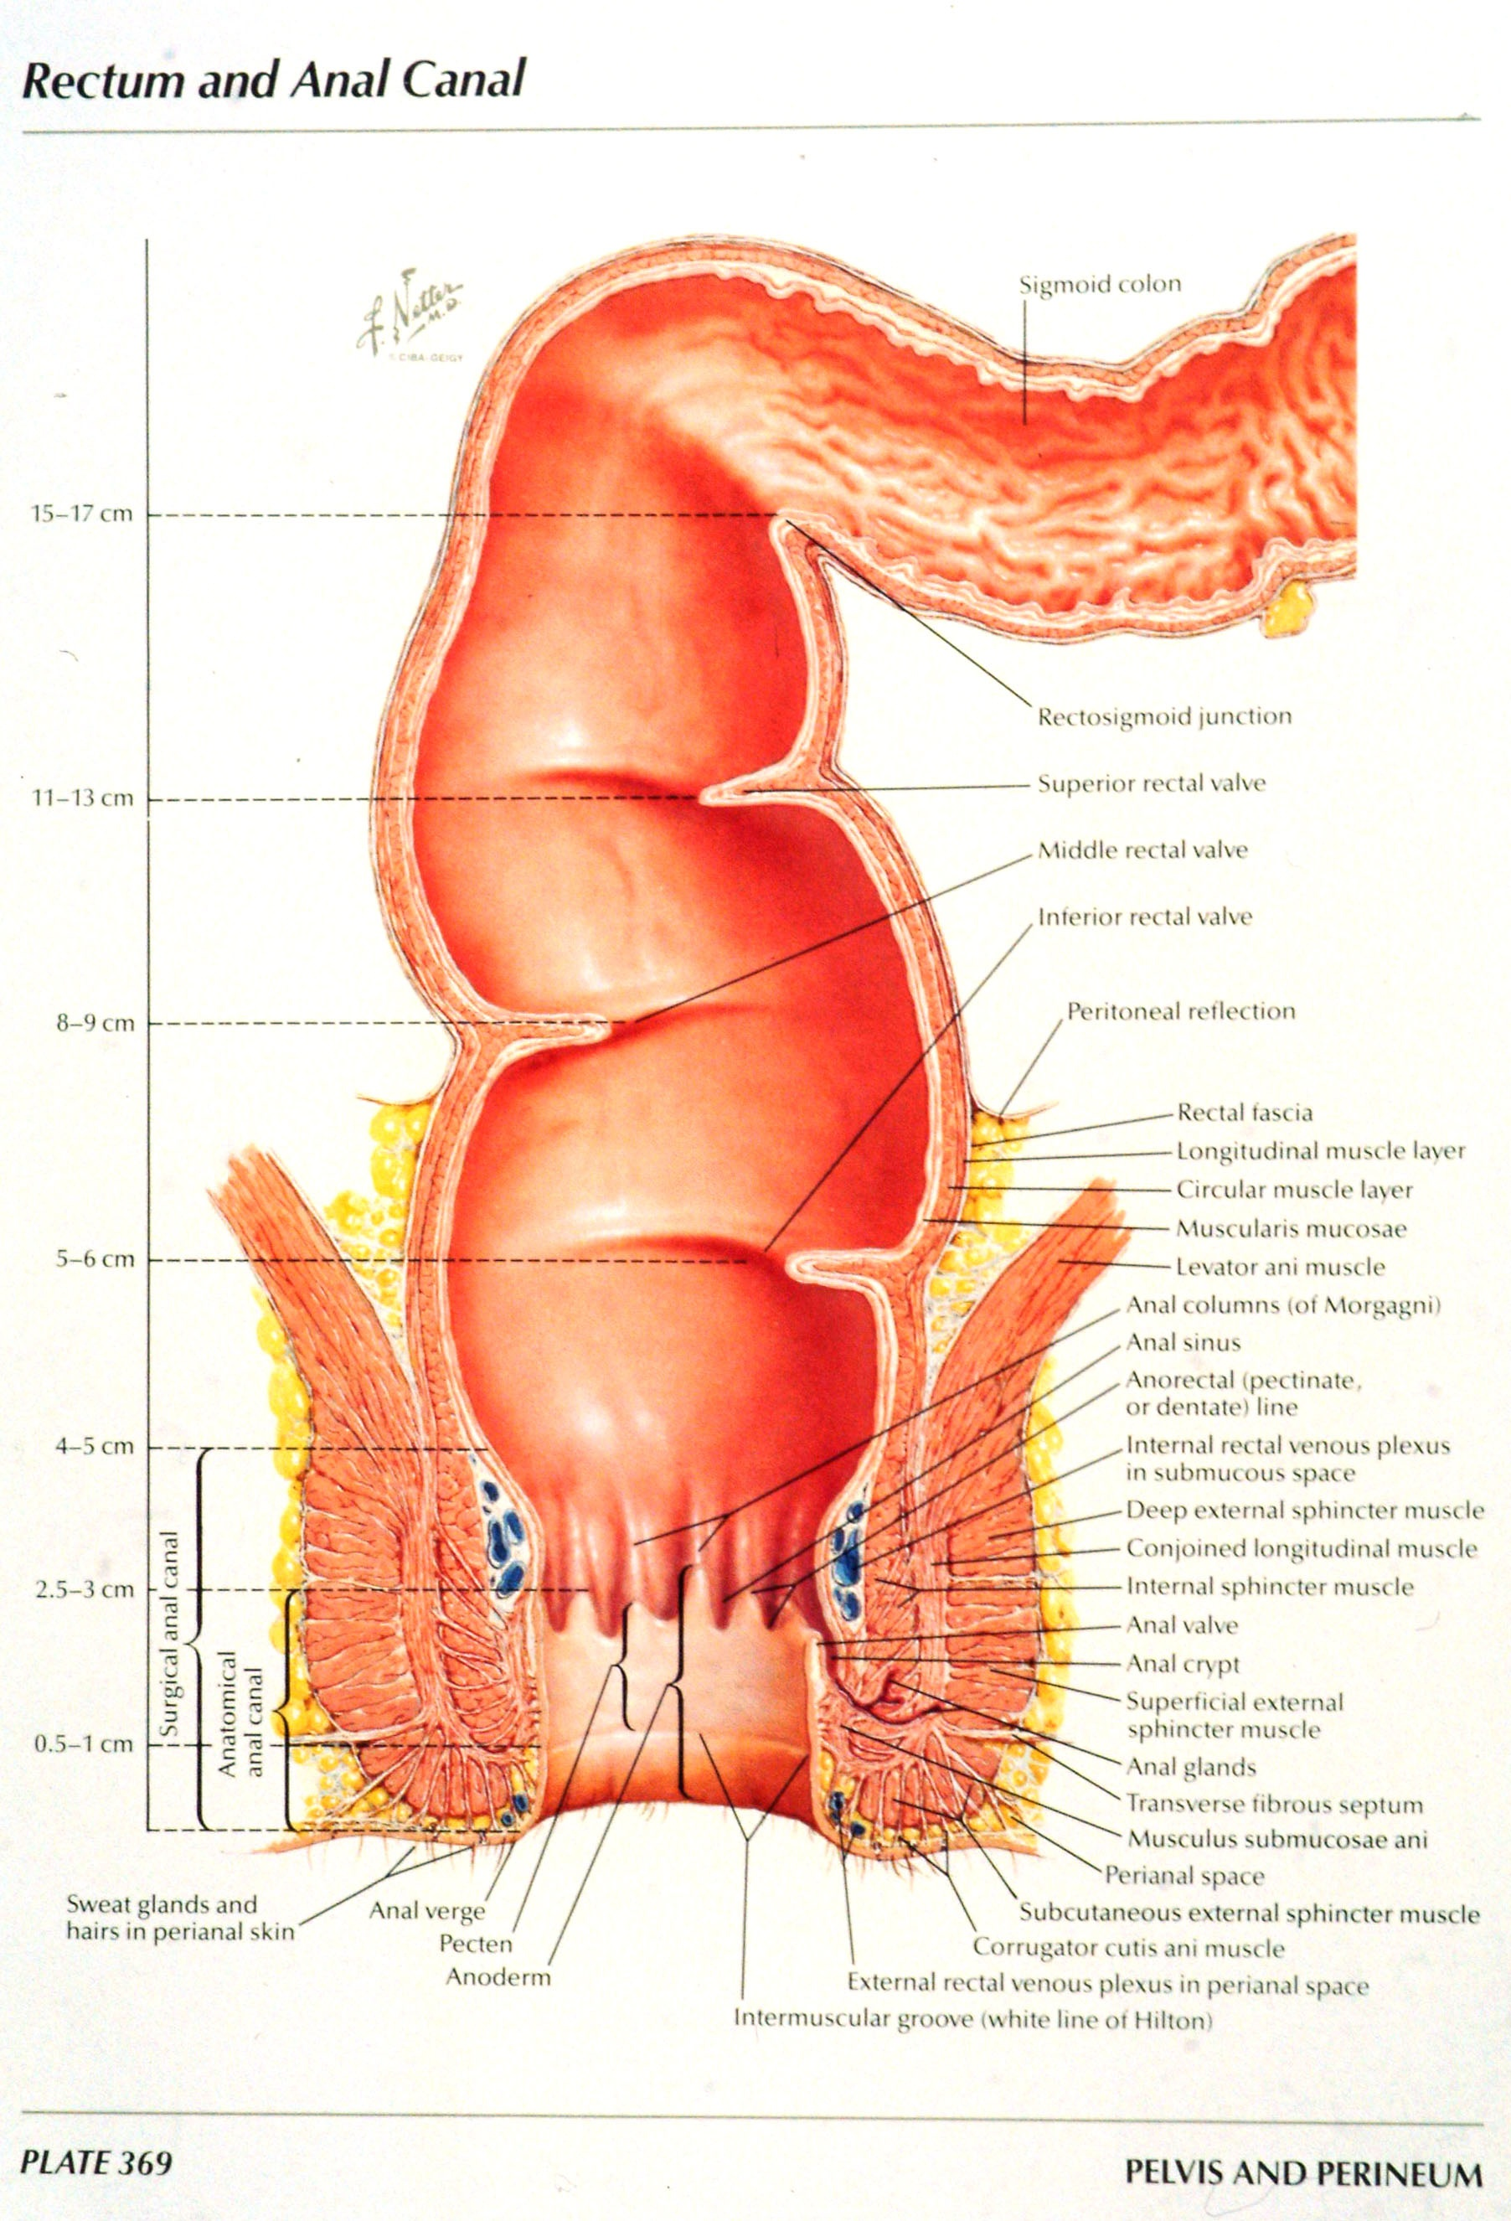

Slide 7
SPHINCTER-SPARING TECHNIQUES (SST) 19th AND 20th CENTURIES
LISFRANC, VERNEUIL, WITZEL, KOCHER, KRASKE, BABCOCK, HOCHEREGG, MILES
EARLY SURGEONS WHO EMPLOYED SST

Slide 8
STAGING OF RECTAL CANCER
PHYSICAL EXAM
CT SCAN
TRANS RECTAL ULTRA SOUND
MRI

Slide 9
PRIMARY TUMOR
T1 TUMOR INVADES SUBMUCOSA
T2 TUMOR INVADES MUSCULARIS PROPRIA
T3 TUMOR INVADES THROUGH MUSCULARIS PROPRIA INTO SUBSEROSA
T4 TUMOR DIRECTLY INVADES OTHER ORGANS OR STRUCTURES

Slide 10
RISK OF LYMPH NODE METASTASIS
T1 - 3-10%
T2 - 10-30%
T3 - NOT RECOMMENDED FOR LOCAL EXCISION

Slide 11
REGIONAL LYMPH NODES
N1 METASTASIS IN 1-3 LYMPH NODES
N2 METASTASIS IN 4 OR MORE LYMPH NODES
N3 METASTASIS IN ANY LYMPH NODE ALONG THE COURSE OF A NAMED VASCULAR TRUNK

Slide 12
DISTANT METASTASIS
M0 NO DISTANT METASTASIS
M1 DISTANT METASTASIS

Slide 13
SPHINCTER-SPARING APPROACHES
LOW ANTERIOR
PULL THROUGH PROCEDURE
ABDOMINAL TRANSSACRAL
ENDO-ANAL OR COLO-ANAL ANASTOMOSIS
TRANS-SPHINCTERIC
TRANS ENDOSCOPIC MICRO SURGERY –TEMS
Trans Anal excision

Slide 14
MY OWN VIEW:
PULL THROUGH (TWO-STAGE) OPERATIONS HAVE TOO HIGH INCONTINENCE RATES (16-35%)
COLO-ANAL ANASTOMOSIS HAVE INCONTINENCE OF ABOUT 40%
ABDOMINAL TRANS-SPHINCTERIC DIVIDE SPHINCTER POSTERIORLY

Slide 15
Sphincter sparing approaches for lower rectal cancer have evolved along two lines:
Superficial cancers T1, T2
Patients with larger lesions that undergo neoadjuvant therapy

Slide 16
Superficial lesions can be resected by a variety of methods
The only definitive indication, supported by randomized trials, for neoadjuvant therapy is for T3 or T4 – results show lower local recurrence rates (6 vs 13%)

Slide 17
Relative indications for neoadjuvant therapy
Clinically node positive disease –MRI or EUS
Distal rectal tumor where APR is thought advisable
Tumor which involves the mesorectal fascia

Slide 18
Two effects of neoadjuvant treatment that need mention-good or bad ?
About 15-20% of patients will have cCR
About 20% will be down staged in the lymph nodes

Slide 19
LOCAL EXCISION
TECHNIQUE LIMITATIONS:
LIGHT
RETRACTION

Slide 20
TRANSSACRAL EXCISION
TECHNIQUE LIMITATIONS:
RECTAL MOBILIZATION
SPACE CONSIDERATION
SACRAL BONE

Slide 21
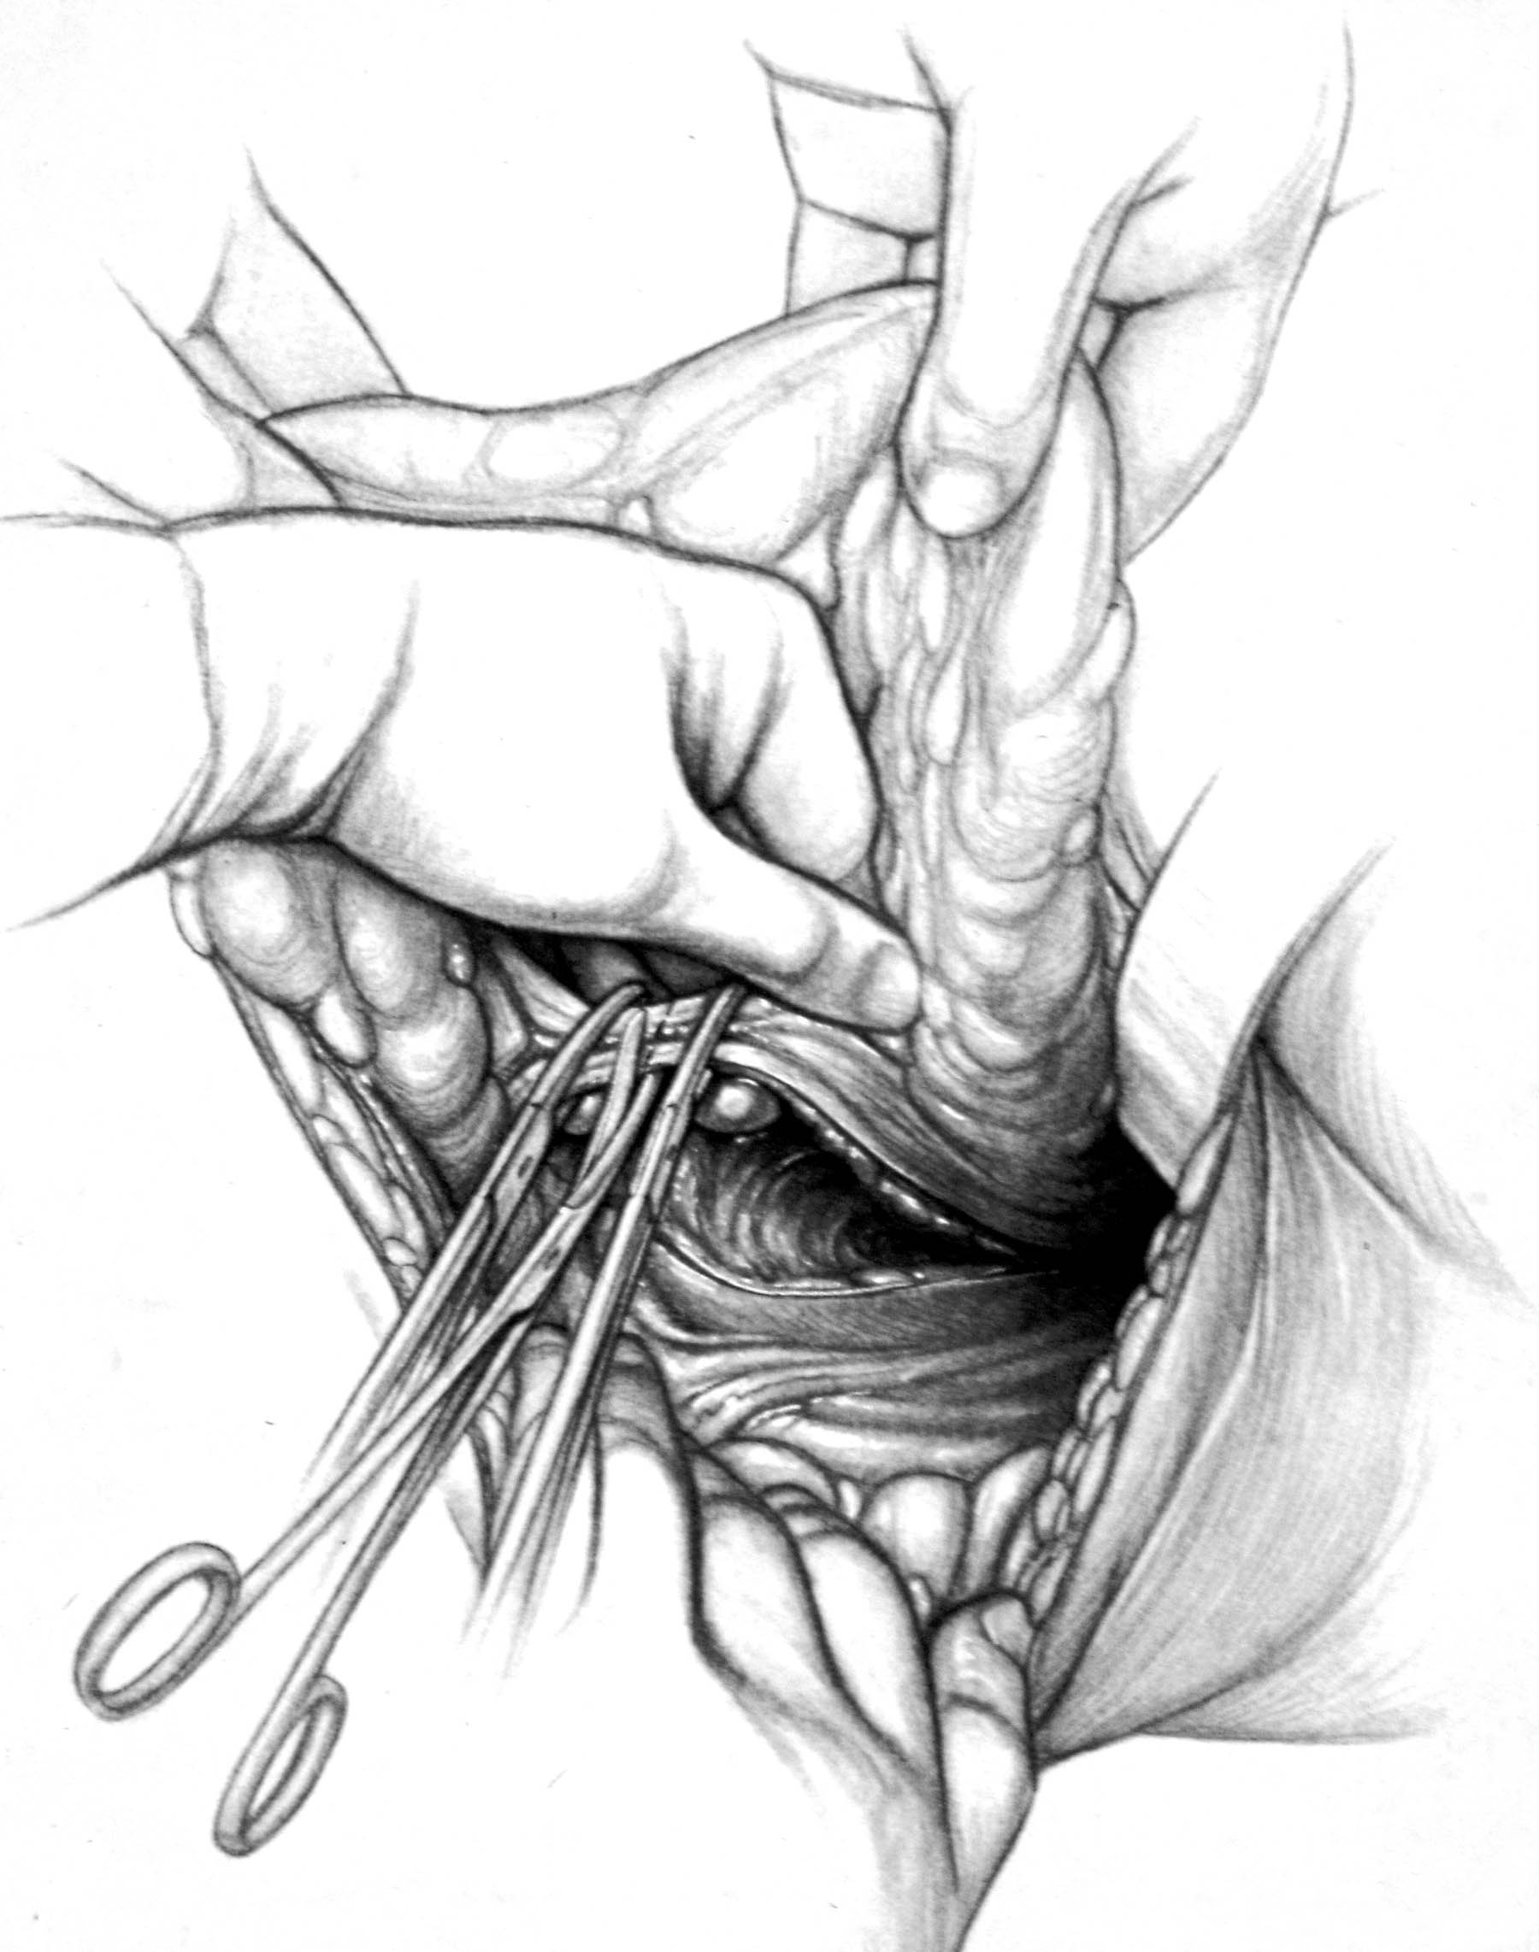

Slide 22
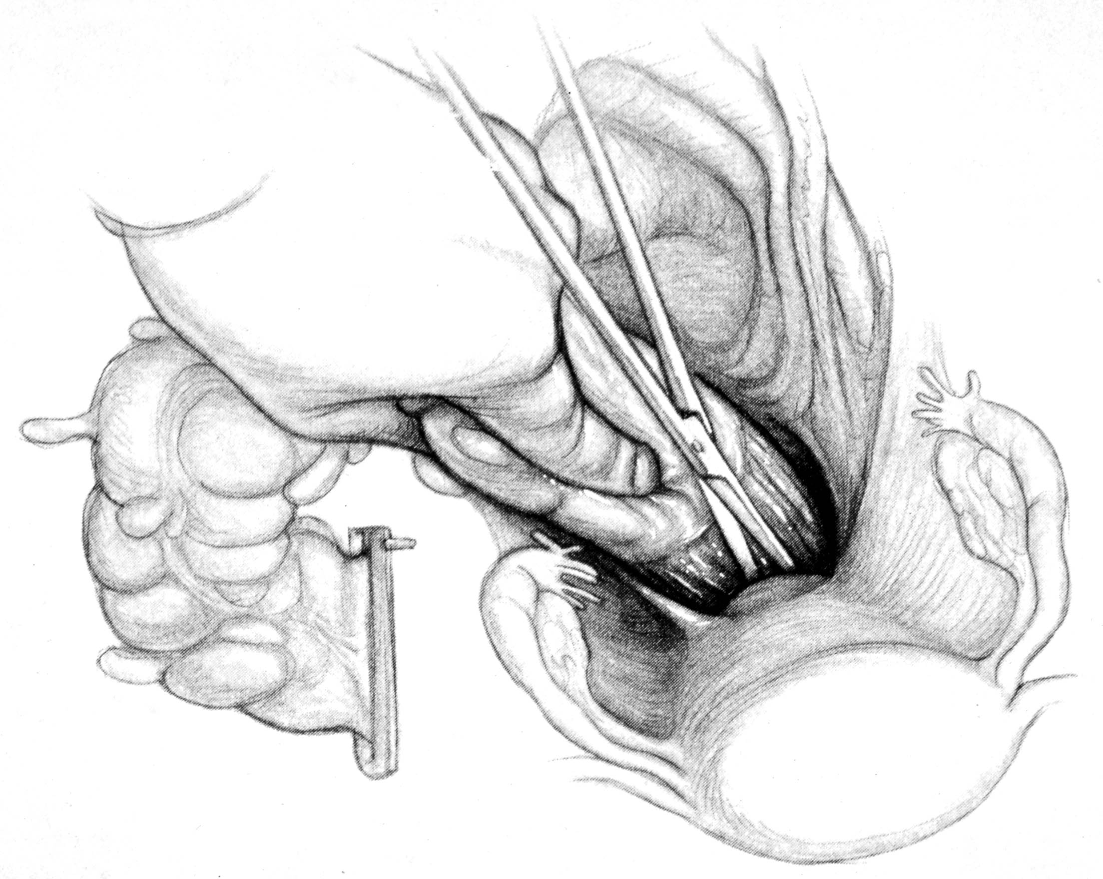

Slide 23
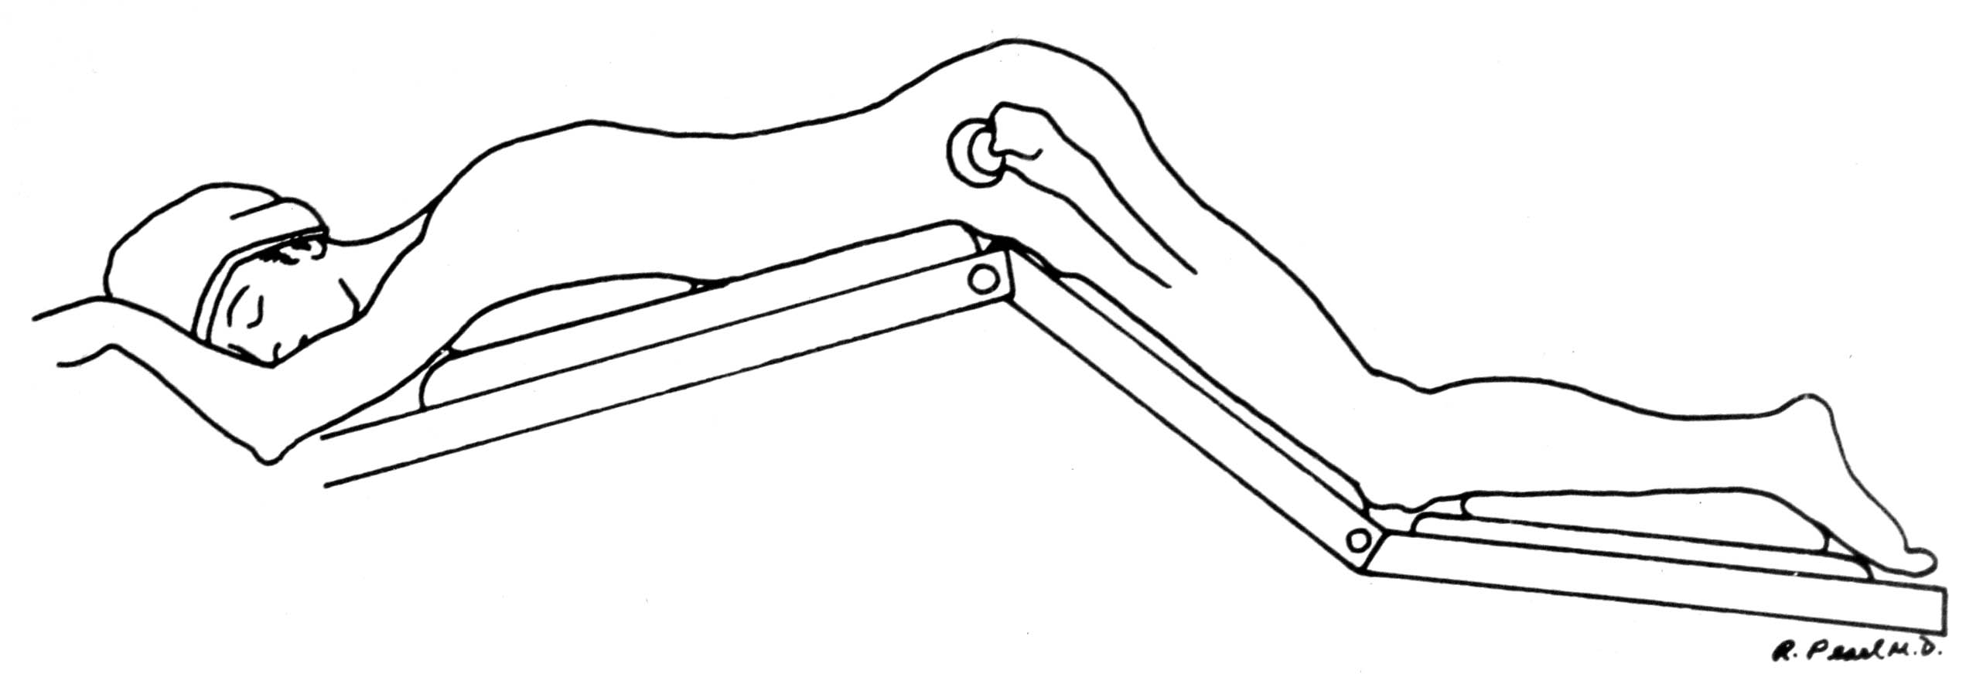

Slide 24
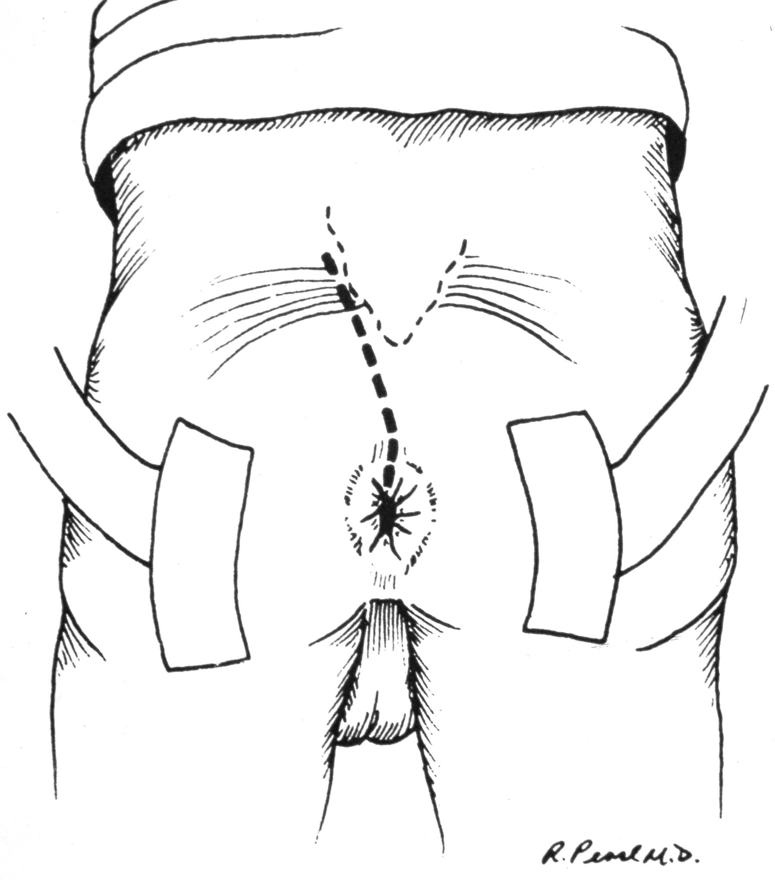

Slide 25
BONE RESECTION
3 SACRAL SEGMENTS - ONE SIDE

Slide 26
LAPAROSCOPIC or Open Abdominal TRANSSACRAL EXCISION
Diversion may be required ileostomy or colostomy
Can be stapled or hand sewn
Must keep stool loose to keep intra rectal pressure low while healing
Fistulas heal but may require diversion

Slide 27
TransEndoscopic MicroSurgery
Magnified binocular view
Can resect up to 20cm
Excision with margins—suture
Low pressure insufflation-CO2
Similar indications to trans-anal resection

Slide 28
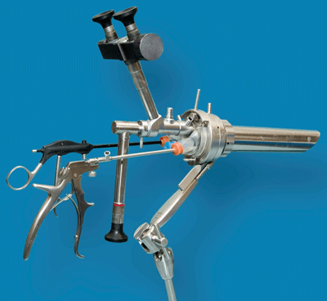
Trans endoscopic microsurgery

Slide 29
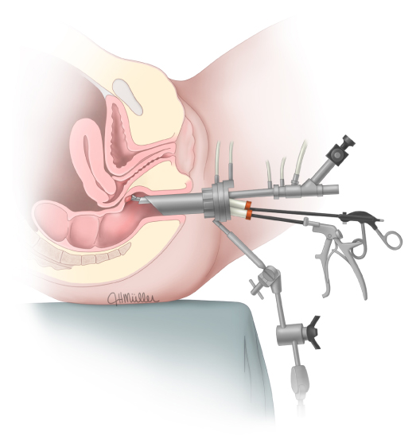
Transendoscopic Microsurgery TEM

Slide 30
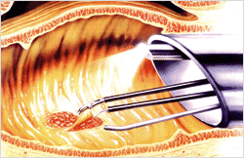
TEM

Slide 31
POST-OP THERAPY
ALL - T2 OR GREATER
ALL - NODAL POSITIVE

Slide 32
Role of watchful waiting for cCR
Brazil group reports:
71 patients had cCR and were watched – median 57 mo.
2 patients (7%) relapsed and were salvaged with APR
3 developed metastatic disease
disease specific survival 92% at 5 years
follow up studies suggest that lowest relapse is with T2 lesions compared to T3/4 lesions (3 vs 30%)

Slide 33
3 POINTS
INTENT TO CURE MUST NOT BE LOST
STAGING IS CRITICAL
PHYSICAL EXAM
CT SCAN
ULTRA SOUND-MRI
T2 lesions resect first then adjuvant therapy; T3 begin with neoadjuvant therapy then restage and re biopsy
Trans anal for lesions below 5 cm; Trans-sacral or TEMS for 5-8 cm
PATIENCE WITH COMPLICATIONS

Slide 34
CONCLUSIONS
STRATEGIES FOR TREATING RECTAL CANCER INVOLVE CAREFUL PRE-OPERATIVE STAGING
INTENT TO CURE MUST NOT BE LOST
3/4 OF PATIENTS WITH RECTAL CANCER CAN HAVE SPHINCTER PRESERVATION
BE PREPARED TO MANAGE “COMPLICATIONS”
FUTURE OF RECTAL CANCER WILL INVOLVE FEWER COMPLETE RECTAL AMPUTATIONS

Slide 35
KRASKE
ANTERIOR WALL
POSTERIOR WALL-easier with tatoo
AVERAGE NODAL RECOVERY: 0.9 NODES

